Slide 1
Predicting Customer Buying Behaviour
British Airways Dataset

Slide 2
Predicting the Probability that the customer will complete the booking given the input parameters such as: 'num_passengers', 'sales_channel', 'trip_type', 'purchase_lead', 'length_of_stay', 'flight_hour', 'flight_day', 'route', 'booking_origin', 'wants_extra_baggage', 'wants_preferred_seat', 'wants_in_flight_meals', 'flight_duration'
Task

Slide 3
Methodology
Text Vectorising
Correlation Analysis
Dataset Preparation
Prediction using Regression
Model Evaluation

Slide 4
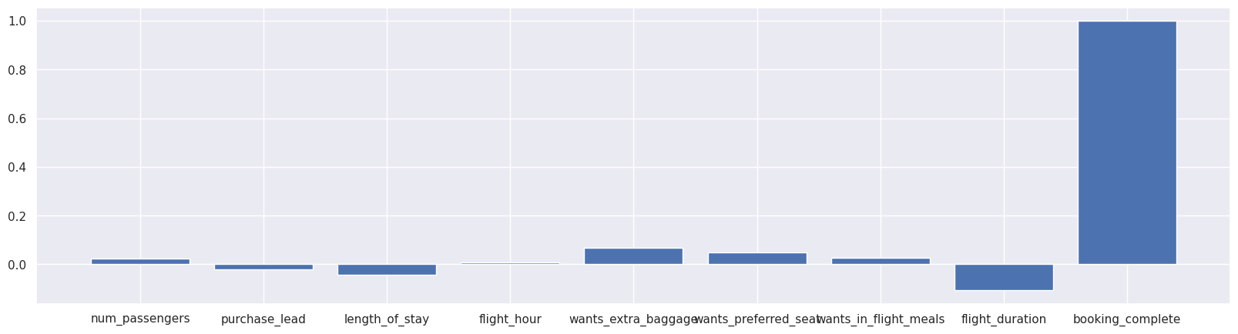
Correlation Analysis
Correlation of various parameters with booking_complete parameter
Parameters such as Flight hours, Number of Passengers, and Purchase Lead are of less significance and parameters such as Extra Baggage Allowance, Seat Preference, Flight Duration and Length of Stay are of more significance in predicting the probability of booking a seat.

Slide 5
Prediction Model
Voting Regressor using:
Gradient Boosting Regressor
Random Forest Regressor
Linear Regression
Decision Tree Regressor

Slide 6
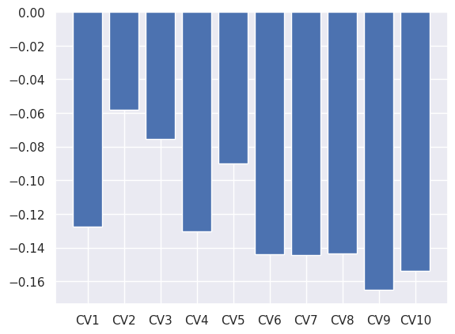
Model Evaluation: Cross Validation Score
10 cross validations
Cross Validation Score per Iteration
Results
Mean Cross Validation score:
-0.12323314635040386

